Slide 1
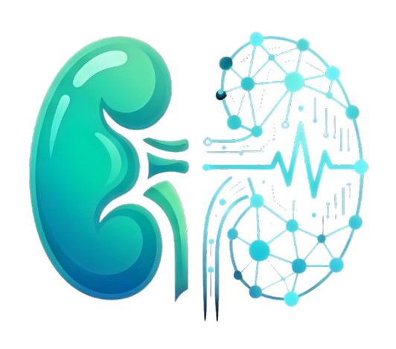
TwinBean
Kidney digital twin
24-hour acute kidney injury
risk review
Synthetic EHR history and simulated home monitoring
in one clinician review workflow
Happiest Health Hackathon 2026
TwinBean • Synthetic research prototype
01
Notes:
Source: supplied TwinBean project archive; README.md; PROJECT.md; frontend/public/twinbean-logo.png

Slide 2
The problem TwinBean addresses
Fragmented evidence
Difficult prioritization
Periodic health records and home-monitoring observations sit in separate streams.
A clinician needs to see current changes, valid forecasts, and evidence gaps together.
Ambiguous model output
Focused scope
A missing prediction must remain unavailable; displaying zero would imply low risk.
The prototype reviews a new AKI event within 24 hours in synthetic adults with CKD.
TwinBean • Synthetic research prototype
02
Notes:
Source: supplied TwinBean project archive; README.md, Problem statement and Healthcare use case

Slide 3
What the digital twin represents
One patient, aligned evidence
A time-stamped computational view of kidney-related history and simulated observations, updated through the prototype data workflow.
CKD
AKI
Chronic kidney disease: the long-term condition represented in the synthetic cohort.
Acute kidney injury: the new event targeted by the 24-hour prediction.
TwinBean • Synthetic research prototype
03
Notes:
Source: supplied TwinBean project archive; PROJECT.md; README.md, Two-stream workflow

Slide 4
Two data streams, preserved provenance
Historical EHR
Simulated medical IoT
Demographics and CKD stage
Encounters and medications
Creatinine, eGFR, BUN, potassium
Weight observations
Blood-pressure time series
Heart-rate observations
Patient ID + UTC prediction cutoff
Both streams retain source labels, cohort ID, generator version, and synthetic provenance.
The current model uses four inputs; other measurements provide review context.
TwinBean • Synthetic research prototype
04
Notes:
Source: supplied TwinBean project archive; README.md; docs/SYNTHETIC_DATA.md; backend/app/synthetic_data.py

Slide 5
The clinician review workflow
01
Authenticate
Sign in with Firebase; the backend verifies a trusted doctor role.
02
Prioritize
Review current creatinine criteria and valid future-risk results.
03
Inspect
Open patient history, simulated trends, timestamps, and SHAP influence.
04
Document
Save a doctor note and download a protected patient PDF.
TwinBean • Synthetic research prototype
05
Notes:
Source: supplied TwinBean project archive; README.md, Prototype workflow; frontend/src/components/dashboard-screen.tsx

Slide 6
Dashboard and review queue
Clinical overview
Monitored patients
Shows monitored patients, current criteria met, and available predictions.
Search by patient or CKD stage; filter by current rules or prediction availability.
Review priority
Review workspace
The overview highlights current criteria first; otherwise it uses the highest valid risks.
Priority patients without a saved review note appear in the pending queue.
TwinBean • Synthetic research prototype
06
Notes:
Source: supplied TwinBean project archive; frontend/src/components/dashboard-screen.tsx; doctor-dashboard.tsx

Slide 7
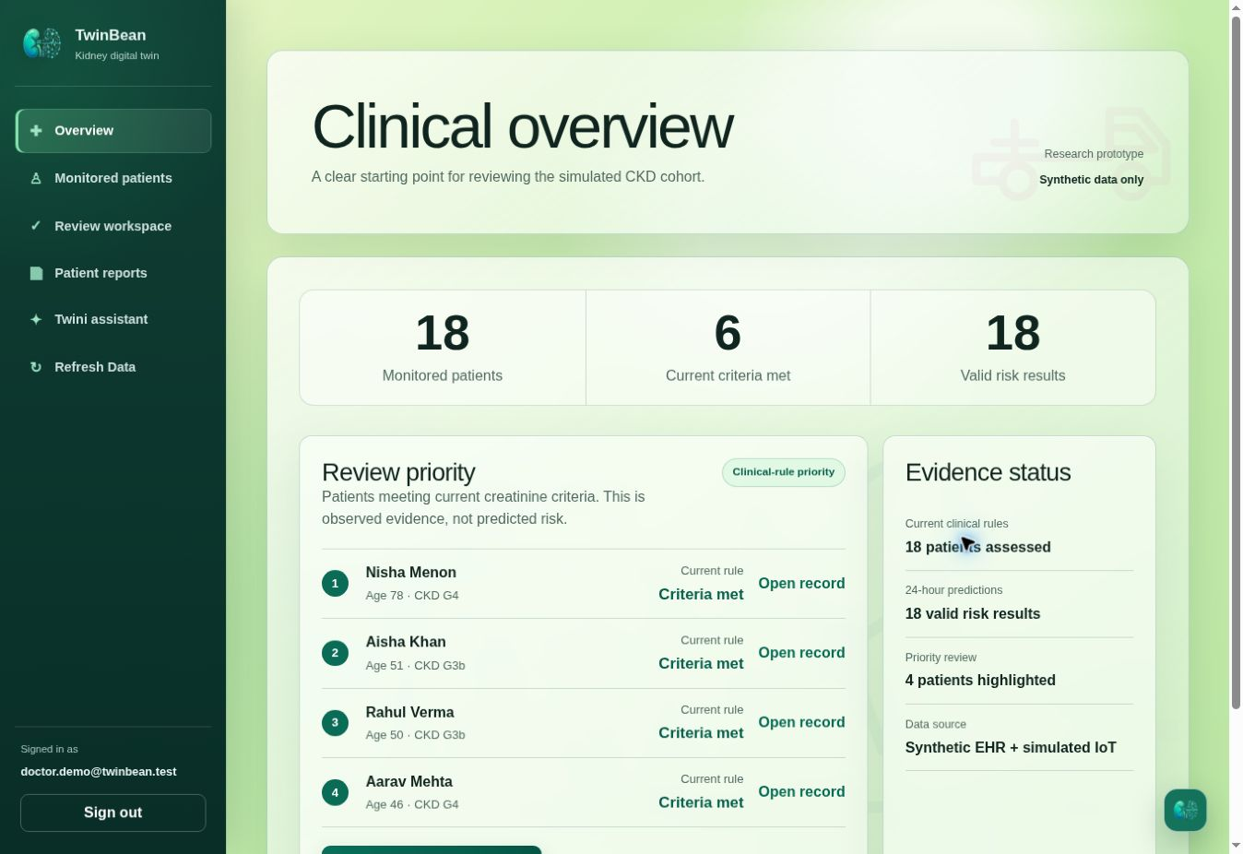
Clinical overview in the live demo
18 monitored patients
The overview displays six patients meeting current creatinine criteria and 18 available risk results.
Priority uses observed criteria before model-based ranking.
TwinBean • Synthetic research prototype
07
Notes:
Source: actual authenticated TwinBean demo UI at https://twinbean.vercel.app/dashboard. Captured 23 October 2026. The website identifies these records as synthetic. Prediction timestamps are historical saved demo outputs, not live clinical forecasts.
The overview displays six patients meeting current creatinine criteria and 18 available risk results. Priority uses observed criteria before model-based ranking.

Slide 8
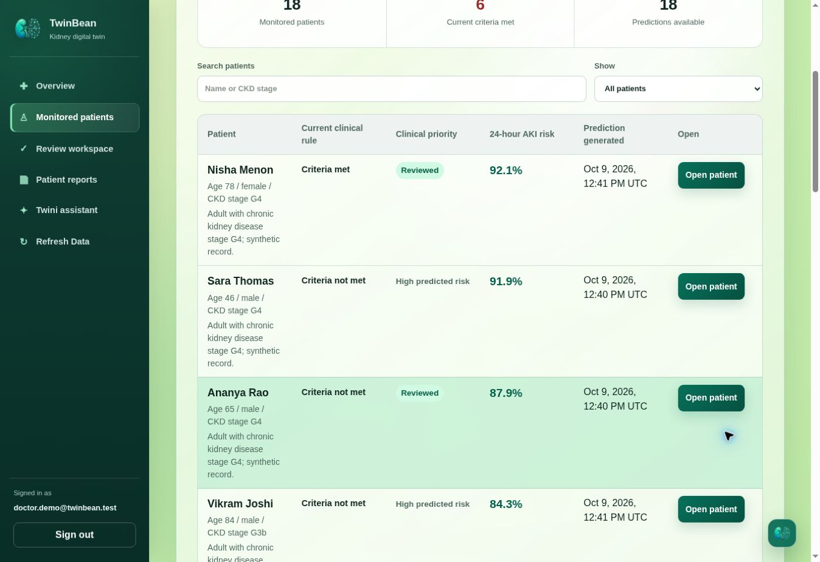
Monitored patients and risk ordering
Separate review signals
Current rule, clinical priority, 24-hour probability, and generation time appear in distinct columns.
Search and filters support cohort review. Values are saved synthetic demo outputs.
TwinBean • Synthetic research prototype
08
Notes:
Source: actual authenticated TwinBean demo UI at https://twinbean.vercel.app/patients. Captured 23 October 2026. The website identifies these records as synthetic. Prediction timestamps are historical saved demo outputs, not live clinical forecasts.
Current rule, clinical priority, 24-hour probability, and generation time appear in distinct columns. Search and filters support cohort review. Values are saved synthetic demo outputs.

Slide 9
Patient detail: evidence in context
01
History and trends
Review EHR laboratory evidence and simulated IoT observations separately.
02
Observed rule state
Inspect creatinine evidence and the comparison supporting the current rule.
03
Forecast and influence
Check 24-hour probability, data quality, prediction time, and SHAP values.
04
Doctor review
Keep the clinician’s note distinct from generated evidence and explanations.
TwinBean • Synthetic research prototype
09
Notes:
Source: supplied TwinBean project archive; frontend/src/components/patient-detail.tsx; backend/app/patient_routes.py

Slide 10
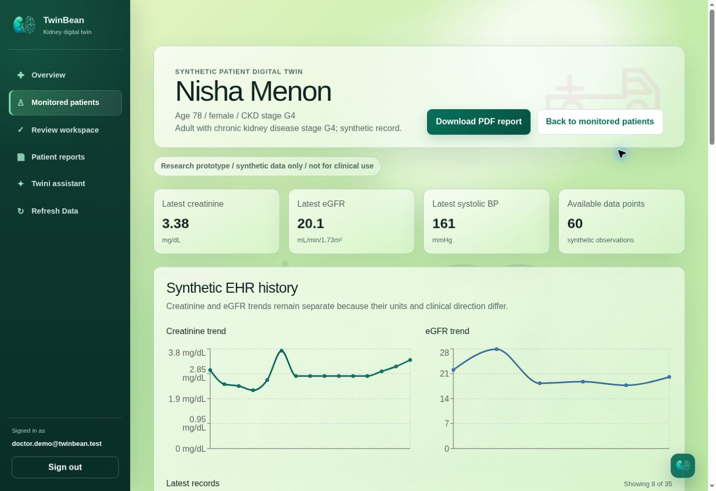
Patient digital twin: history and trends
Synthetic patient example
The patient record shows kidney measurements and separate creatinine and eGFR trends.
The full patient record is available alongside the report action.
TwinBean • Synthetic research prototype
10
Notes:
Source: actual authenticated TwinBean demo UI at https://twinbean.vercel.app/patients/tbp-c13c739da4cf56658db94b92e5aac1da. Captured 23 October 2026. The website identifies these records as synthetic. Prediction timestamps are historical saved demo outputs, not live clinical forecasts.
The patient record shows kidney measurements and separate creatinine and eGFR trends. The full patient record is available alongside the report action.

Slide 11
Current evidence and future risk
Signal | Question answered | Interpretation
Current rule | What does observed creatinine show? | Criteria met / not met / insufficient history
24-hour model | Is a new AKI event forecast? | Probability when inputs pass validation
SHAP explanation | What influenced this model output? | Feature influence in log-odds space
The implemented clinical rule is creatinine-only; urine-output criteria are not assessed.
These are prototype evidence outputs, not diagnosis or treatment guidance.
TwinBean • Synthetic research prototype
11
Notes:
Source: supplied TwinBean project archive; backend/app/clinical_rules.py; aki_features.py; prediction_service.py

Slide 12
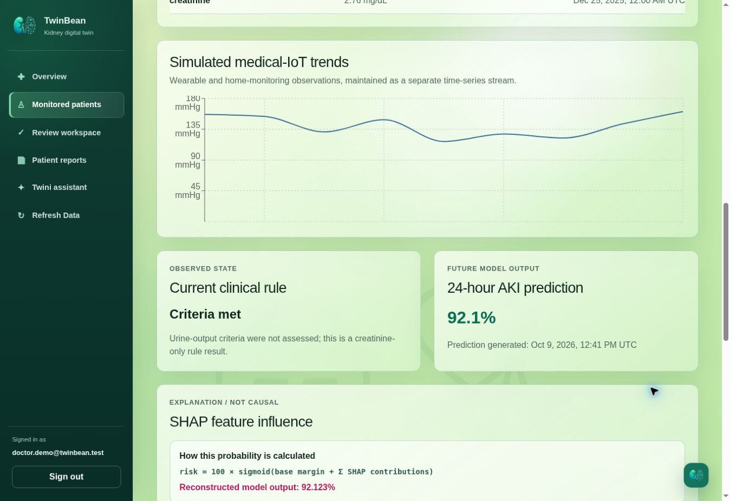
Observed criteria beside predicted risk
Two different outputs
The current creatinine rule is shown beside a saved 24-hour AKI probability of 92.1%.
The forecast’s generation timestamp remains visible. These are synthetic demo outputs.
TwinBean • Synthetic research prototype
12
Notes:
Source: actual authenticated TwinBean demo UI at https://twinbean.vercel.app/patients/tbp-c13c739da4cf56658db94b92e5aac1da. Captured 23 October 2026. The website identifies these records as synthetic. Prediction timestamps are historical saved demo outputs, not live clinical forecasts.
The current creatinine rule is shown beside a saved 24-hour AKI probability of 92.1%. The forecast’s generation timestamp remains visible. These are synthetic demo outputs.

Slide 13
How the 24-hour model works
Four model inputs
Controlled prediction
Age in years
Latest creatinine (mg/dL)
Creatinine change within 48 hours (mg/dL)
Latest systolic blood pressure (mmHg)
Validate evidence and freshness
Build the cutoff-safe feature snapshot
Run the verified XGBoost pipeline
Return probability, metadata, and explanation
The target is a new event in the open next-24-hour window after the cutoff.
TwinBean • Synthetic research prototype
13
Notes:
Source: supplied TwinBean project archive; backend/app/aki_features.py; aki_model.py; model_artifacts/aki-24h-2026.10.08b/manifest.json

Slide 14
Risk unavailable is an explicit result
Missing or invalid evidence never becomes 0% risk
Evidence checks
Integrity checks
Missing creatinine history or comparator
Missing or stale IoT observations
Invalid timestamps, units, or provenance
Model bundle and feature alignment
Finite prediction and SHAP values
Explanation reconciliation with model output
The required observations follow a 24-hour freshness policy. Unavailable results carry reasons for review.
TwinBean • Synthetic research prototype
14
Notes:
Source: supplied TwinBean project archive; backend/app/aki_features.py; aki_explanations.py; prediction_service.py

Slide 15
SHAP explains model influence
Baseline + feature contributions = model raw margin
A positive contribution pushes the model output upward; a negative contribution pushes it downward relative to the model baseline.
Verified explanation
Correct interpretation
The backend checks named features and verifies that the contributions reconcile with the model output.
SHAP describes this model’s behavior. It does not establish causes or recommend an intervention.
TwinBean • Synthetic research prototype
15
Notes:
Source: supplied TwinBean project archive; backend/app/aki_explanations.py; model manifest

Slide 16
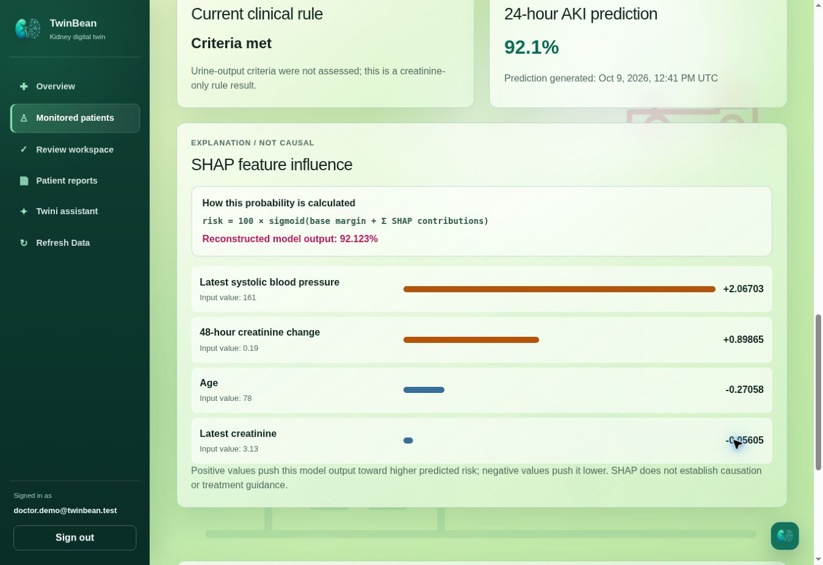
SHAP feature influence in the app
Explain the model output
The view lists feature values and positive or negative contributions, with a reconstructed probability.
Contributions describe model influence; they are not causes or treatment advice.
TwinBean • Synthetic research prototype
16
Notes:
Source: actual authenticated TwinBean demo UI at https://twinbean.vercel.app/patients/tbp-c13c739da4cf56658db94b92e5aac1da. Captured 23 October 2026. The website identifies these records as synthetic. Prediction timestamps are historical saved demo outputs, not live clinical forecasts.
The view lists feature values and positive or negative contributions, with a reconstructed probability. Contributions describe model influence; they are not causes or treatment advice.

Slide 17
Twini: project-grounded assistance
What it uses
Where it appears
Project documentation and optional selected synthetic-patient context, with source labels.
A dedicated assistant workspace and a compact drawer within the clinician experience.
How it runs
Its boundary
Requests go through the authorized backend to a Groq OpenAI-compatible integration.
Educational explanations only. It cannot modify records, rules, predictions, or SHAP output.
TwinBean • Synthetic research prototype
17
Notes:
Source: supplied TwinBean project archive; backend/app/twini.py; frontend/src/components/twini-assistant.tsx; twini-drawer.tsx

Slide 18
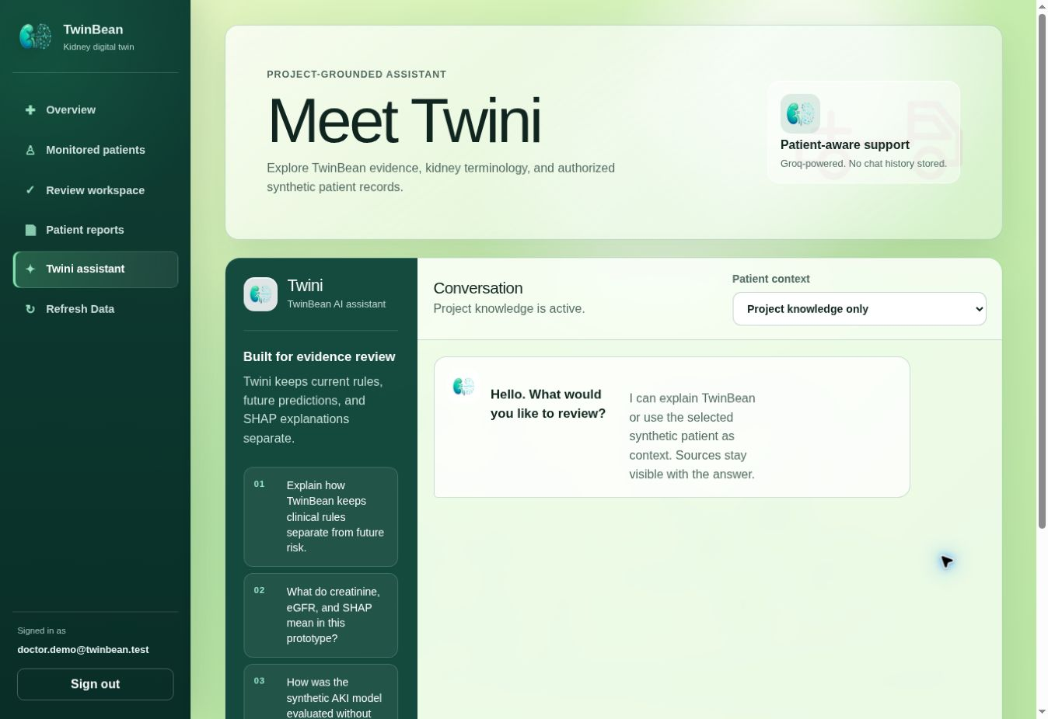
Twini assistant workspace
Project and patient context
Project knowledge and a patient-context selector support the conversation workspace.
Suggested questions explain evidence, terminology, and evaluation.
TwinBean • Synthetic research prototype
18
Notes:
Source: actual authenticated TwinBean demo UI at https://twinbean.vercel.app/assistant. Captured 23 October 2026. The website identifies these records as synthetic. Prediction timestamps are historical saved demo outputs, not live clinical forecasts.
Project knowledge and a patient-context selector support the conversation workspace. Suggested questions explain evidence, terminology, and evaluation.

Slide 19
System architecture and trust boundary
Synthetic generator
Firebase
FastAPI backend
Next.js app
→
→
→
Separate EHR and IoT
Authentication + Firestore
Authorization + evidence
Clinician workspace
Trusted backend services
Token and doctor-role checks • Current rules • XGBoost + SHAP
Protected patient reports • Doctor notes • Twini integration
The browser calls protected APIs; privileged credentials remain server-side.
TwinBean • Synthetic research prototype
19
Notes:
Source: supplied TwinBean project archive; README.md, Architecture; backend/app/auth.py; firestore.py; frontend/src/lib/api.ts

Slide 20
Technology stack and responsibilities
Layer | Technology | Responsibility
Interface | Next.js, React, TypeScript, Recharts | Dashboard, patient trends, assistant
API | Python, FastAPI, Pydantic | Protected evidence and workflow APIs
Identity and data | Firebase Auth, Cloud Firestore | Doctor identity and versioned records
ML and explanation | XGBoost, scikit-learn, SHAP | 24-hour forecast and feature influence
Assistant and reports | Groq API, ReportLab | Grounded responses and patient PDFs
TwinBean • Synthetic research prototype
20
Notes:
Source: supplied TwinBean project archive; README.md, Technical stack; frontend/package.json; backend/pyproject.toml

Slide 21
Synthetic evaluation design
100
74 / 26
synthetic adult CKD patients
training / held-out patients
Both compared models use the same held-out patients. There is no patient overlap between partitions.
Features stop at the prediction cutoff. Labels use the following 24-hour window; patient IDs stay outside the feature matrix.
TwinBean • Synthetic research prototype
21
Notes:
Source: supplied TwinBean project archive; docs/MODEL_EVALUATION.md; backend/artifacts/evals/phase6-model-evaluation.json
The phase6 comparison uses a 74/26 split. The active release manifest separately records 25 held-out patients; these are distinct artifacts. Do not attribute this comparison to an independent clinical validation of the active release.

Slide 22
Measured results on synthetic held-out data
0.781 → 0.811
ROC AUC rises with the added simulated blood-pressure feature.
0.204 → 0.188
Brier score falls; lower is better for this probability-error metric.
Small deterministic cohort • Synthetic research evaluation • No clinical validation
TwinBean • Synthetic research prototype
22
Notes:
Source: supplied TwinBean project archive; docs/MODEL_EVALUATION.md; backend/artifacts/evals/phase6-model-evaluation.json

Slide 23
Full comparison and interpretation
Metric | EHR only | EHR + IoT | Direction
ROC AUC | 0.781 | 0.811 | Higher is better
Average precision | 0.841 | 0.859 | Higher is better
Brier score | 0.204 | 0.188 | Lower is better
Log loss | 0.656 | 0.600 | Lower is better
Accuracy at 0.5 | 0.692 | 0.769 | Higher is better
The 0.5 threshold is descriptive, not a clinical decision threshold. These results do not establish real-world performance.
TwinBean • Synthetic research prototype
23
Notes:
Source: supplied TwinBean project archive; docs/MODEL_EVALUATION.md; backend/artifacts/evals/phase6-model-evaluation.json

Slide 24
Reports, review notes, and secure access
Patient PDF
Review notes
A protected patient-level report separates observed rules, predictions, SHAP influence, and notes.
Doctor-authored observations remain separate from generated evidence; saved notes update queue state.
Authorized access
Credential boundary
The server verifies Firebase ID tokens and requires the exact trusted role: doctor.
Firebase Admin credentials and the AI-provider key remain in backend configuration.
TwinBean • Synthetic research prototype
24
Notes:
Source: supplied TwinBean project archive; README.md; backend/app/patient_report.py; patient_routes.py; auth.py

Slide 25
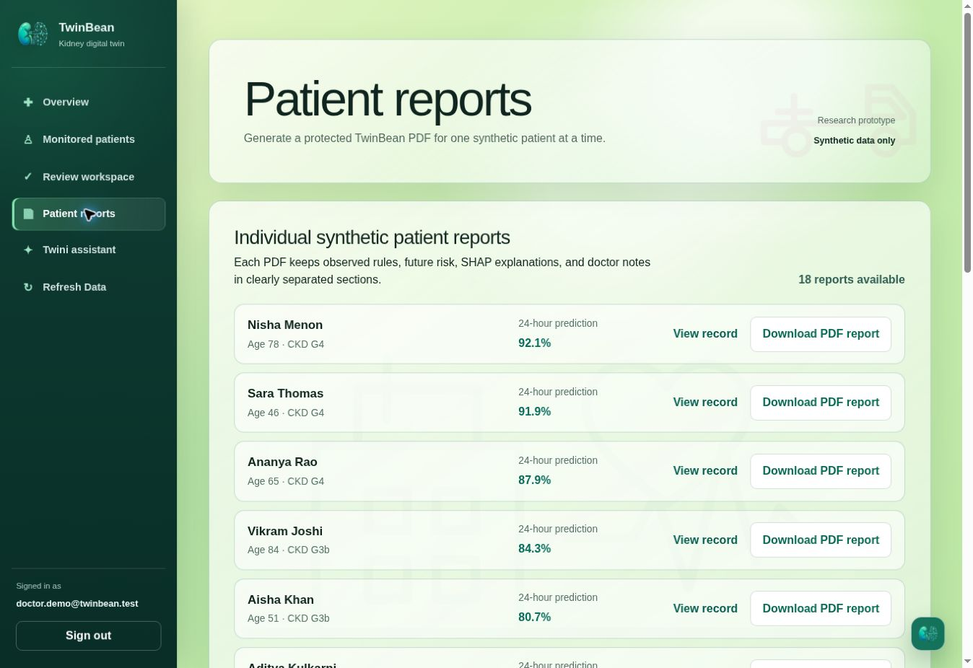
Patient reports workspace
One report per patient
The reports page lists 18 synthetic patient reports with record links and PDF download controls.
Reports keep observed rules, model output, SHAP, and notes in separate sections.
TwinBean • Synthetic research prototype
25
Notes:
Source: actual authenticated TwinBean demo UI at https://twinbean.vercel.app/reports. Captured 23 October 2026. The website identifies these records as synthetic. Prediction timestamps are historical saved demo outputs, not live clinical forecasts.
The reports page lists 18 synthetic patient reports with record links and PDF download controls. Reports keep observed rules, model output, SHAP, and notes in separate sections.

Slide 26
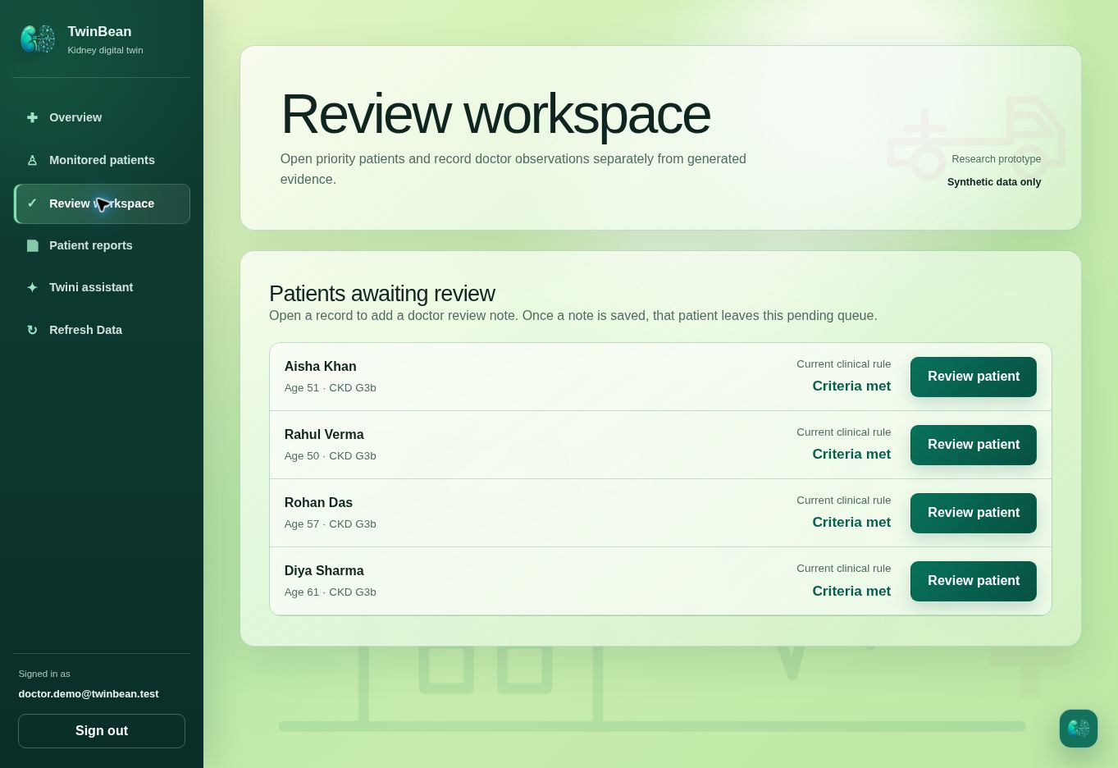
Patients awaiting doctor review
A focused pending queue
The captured queue contains four prioritized synthetic patients awaiting a saved doctor note.
A saved note moves the patient out of this pending queue.
TwinBean • Synthetic research prototype
26
Notes:
Source: actual authenticated TwinBean demo UI at https://twinbean.vercel.app/reviews. Captured 23 October 2026. The website identifies these records as synthetic. Prediction timestamps are historical saved demo outputs, not live clinical forecasts.
The captured queue contains four prioritized synthetic patients awaiting a saved doctor note. A saved note moves the patient out of this pending queue.

Slide 27
Prototype value and next steps
Demonstrated
Required before clinical use
A connected review workflow
Traceable EHR and IoT streams
Explicit unavailable-risk states
Model influence, notes, and reports
Representative clinical data and ethics review
External validation and calibration
Prospective workflow evaluation
Security and regulatory assessment
The prototype demonstrates an approach to review; patient benefit has not been measured.
TwinBean • Synthetic research prototype
27
Notes:
Source: supplied TwinBean project archive; README.md, Limitations and next steps; PROJECT.md

Slide 28
TwinBean
Kidney evidence, organized
for clinician review
Traceable data. Separate signals. Explainable model output.
Synthetic research proof of concept
Not a medical device • Not for diagnosis or treatment
TwinBean • Synthetic research prototype
28
Notes:
Source: supplied TwinBean project archive; README.md; PROJECT.md

